Slide 1
IPL Visualization Assignment

Slide 2
AGENDA
Objective
Background
Key Findings
Appendix:
Data Sources
Data Methodology

Slide 3
Objective
To Find the Match Statistics-
Toss outcome vs Match outcome (for each Ground/Venue)
Biggest wins (by runs and by wicket)
Highest totals (across all the seasons)
To Find the Player Statistics-
Orange cap contenders (Particular Season)
Purple cap contenders (Particular Season)
Batsmen who have hit the most number of fours and sixes (Per Season and Overall)
To Find the Team Statistics-
Season – wise team performance
Win percentage (Home vs Away)

Slide 4

Background
Indian Premier League, or IPL, is a T20 cricket league, which was founded
in 2008 and is held every year.
Eight teams representing eight Indian cities compete with each other in a double round-robin format in the league stages, which are followed by playoffs.
IPL has become one of the most-watched and most attended live sporting events all over the world.

Slide 5


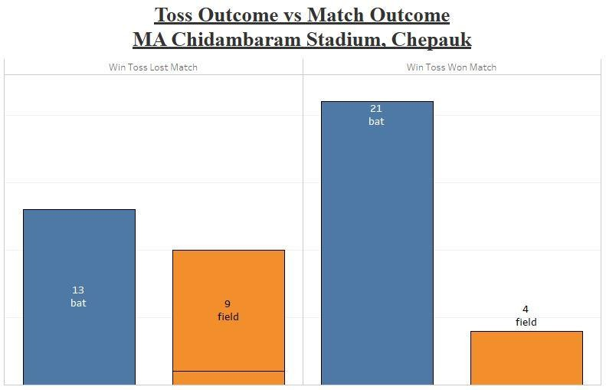
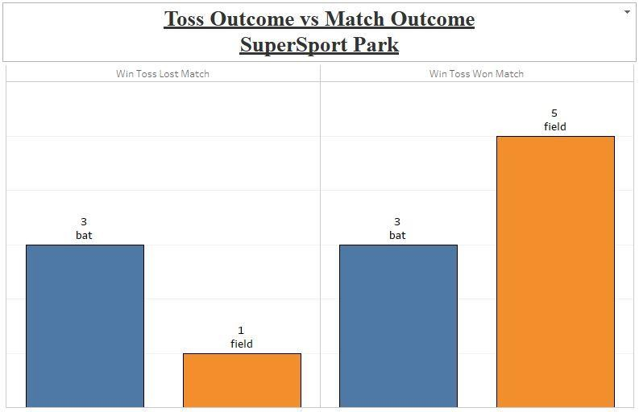
Toss outcome vs Match outcome
Team who Field First in the match win almost 86% of the matches at M Chinnaswamy
Stadium.
Team who Bat First in the match win almost 73% of the matches at MA Chidambaram
Stadium, Chepauk.

Slide 6


Toss outcome vs Match outcome
There is 50%-50% Chances to win the match if team select Bat or field first if they are
playing on SuperSport Park, Centurion.

Slide 7


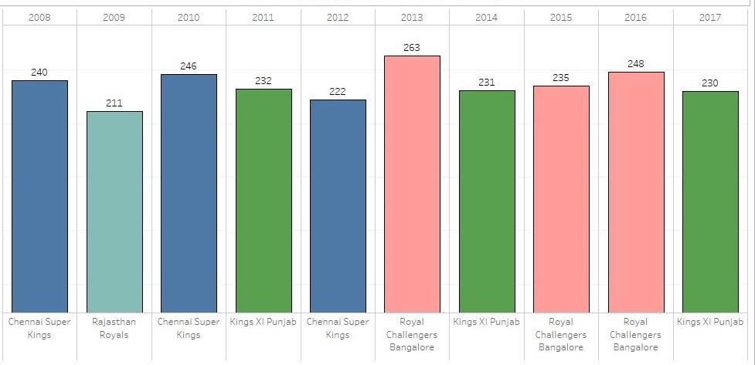
Highest Total in Every Season
263 is the highest total scored by Royal Challengers Bangalore in 2013
Chennai Super Kings, Royal Challenges Bangalore & King XI
Punjab scored highest total of season 3 times.
Rajasthan Royals Scored highest total only 1 time in 2009.

Slide 8


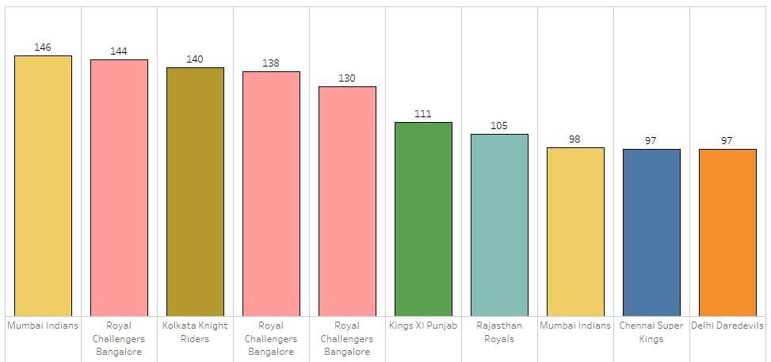
Highest Wins by Runs
Mumbai Indians have the highest wins by runs is 146.
Royal Challengers Bangalore is the team that have 3 times wins in top 5 highest win by runs.

Slide 9


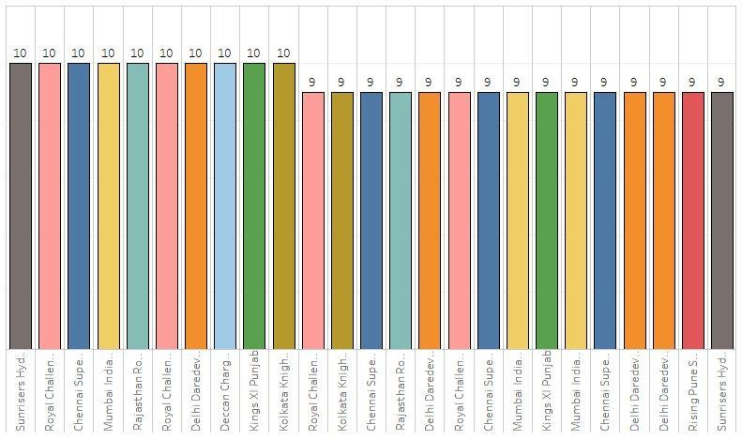
Highest Wins by Wickets
All team which is in top 10 have the win by 10 wickets.
Royal Challengers Bangalore is the team that have 2 times wins in top 5 highest win by Wickets.
Royal Challengers Bangalore is the team that have 4 times wins in top 25
highest win by wickets.

Slide 10

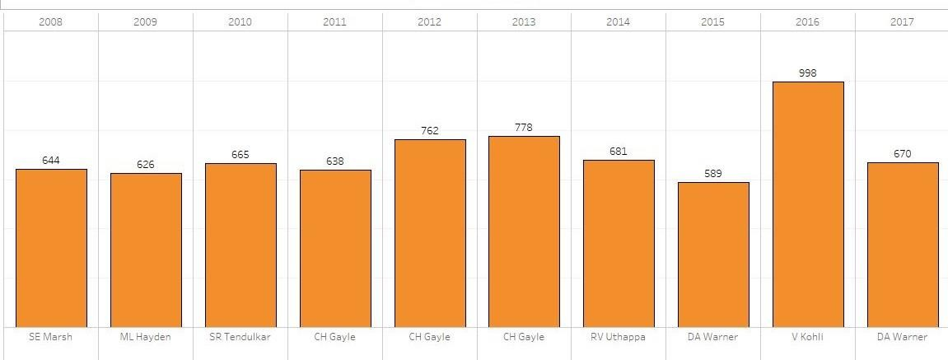
Orange Cap Winner (Per Season)
Chris Gayle won 3 orange Caps form 2011 to 2013.
Virat Kohli scored 998 in 2016 which the highest runs score by any
batsman in any particular season.
After Chris Gayle, David Warner won Orange cap most times.

Slide 11
Purple Cap Winner (Per Season)
DJ Barvo Take highest wicket across all seasons in 2013.
In 2011 SL Malinga & In 2012 M Morkel Take 30 wickets for purple cap.
DJ Bravo, B Kumar won Orange cap most times.

Slide 12


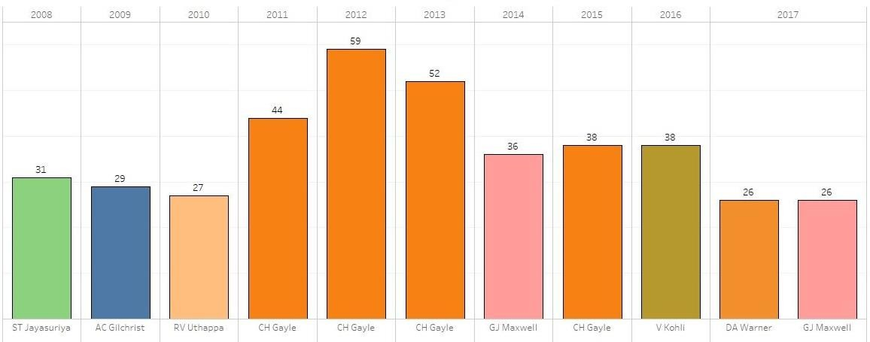
Most No. 6s hit by Batsmen (Per Season)
Most batsmen who are the orange cap winner hit the most number of sixes. for example – CH Gayle from 2011-2013 wins the orange cap hit the most number of sixes in a season.
CH Gayle hit most sixes in a season 4 times, in 2011-2013 & 2015.
CH Gayle hit 59 sixes which is most sixes hit by any batsman across all seasons.

Slide 13


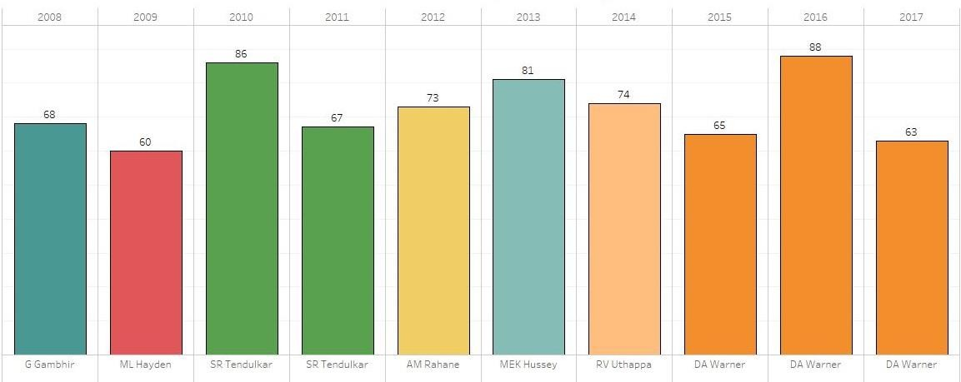
Most No. 4s hit By Batsmen (Per Season)
DA Warner who are the orange cap winner in 2015 also hit the most number of fours (65) in that season.
DA Warner hit most fours in a season 3 times, in 2015-2017.
DA Warner hit 88 fours in 2016 which is highest across all seasons.

Slide 14


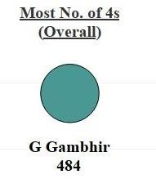
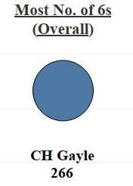
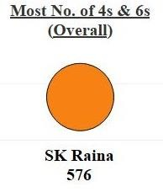
Most No. 4s & 6s hit By Batsmen (Overall)
Gautam Gambhir hits the Most fours (484) which is the total fours hit in every
season.
CH Gayle hits the Most Sixes (266) which is the total sixes hit in every season.
SK Raina hits the most boundaries (576) which is the total of no. 4s & 6s of every season.

Slide 15


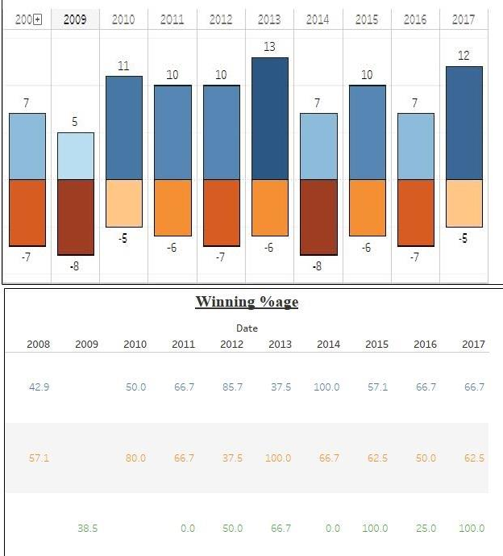

Season wise Team Performance
Mumbai Indians have the overall highest win almost average of 9 wins/season in which almost average 57% of home win & almost average 52% away win and average 28% of win on other ground.

Slide 16

Appendix- Data Sources
I use the Following data Sources:
Per match data
Ball by ball match data

Slide 17

Appendix- Data Methodology
We conducted a thorough analysis of the IPL Data. The process included:
Using the different plot to find the relation between the various
columns.
Creation of New variables.
Creation the different Columns with the calculated field.

